Slide 1
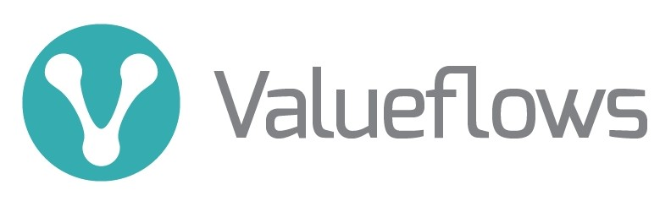
A vocabulary for economic networks
https://valueflo.ws

Slide 2
Valueflows is a standard vocabulary
Valueflows is a vocabulary to describe flows of economic resources of all kinds within distributed economic ecosystems
Its purpose is to enable inter-networking among many different software applications, used by many different kinds of economic formations
Examples are value networks, supply chains, joint ventures, business collaboration networks…. as well as individual organizations
Valueflows supports
  Exchange/transfer (mutual credit, marketplace, e-commerce, offer/request matching, gift economy, contribution economy, mutual aid, etc.)
  Production/creation (manufacturing, supply chain, distribution, digital and knowledge works, services, etc.)

Slide 3
Valueflows is based on REA
REA stands for Resources, Events, Agents.
Agents are individual persons or organizations or ecological agents, who perform Economic Events affecting Economic Resources.
An Economic Event can take actions like produce, modify, consume, or use Economic Resources, or transfer them from one Agent to another.
Economic Resources could be
Useful goods and services
Knowledge, designs
Money, alternate currencies, tokens, credits
Types of work, skills
CO2, methane, heat
Air, water, soil microbiota
. . .

Slide 4

Levels of the Valueflows ontology
The Knowledge level represents classification, policies, procedures, rules and patterns. This is where each network or community can configure the core concepts to fit their needs.
The Plan level represents offers and requests, schedules and promises. This level can also support budgeting or other pre-operational general planning.
The Observation level represents what really happened. This is used for coordinating operations, accounting, other reporting and analysis.

Slide 5

Flows: input-process-output
The first basic pattern for modeling resource flows is input-process-output. When an output from one process becomes an input to another, those processes are connected.
Processes can be defined at whatever level makes sense. For example, having 3 processes in this flow allows operational flexibility: The baker can make a lot of dough and use it for blueberry and pumpkin pie, as well as apple pie. Then she might want to bake different kinds of pies in one oven at the same time too, or freeze half of the unbaked apple pies to bake later.

Slide 6
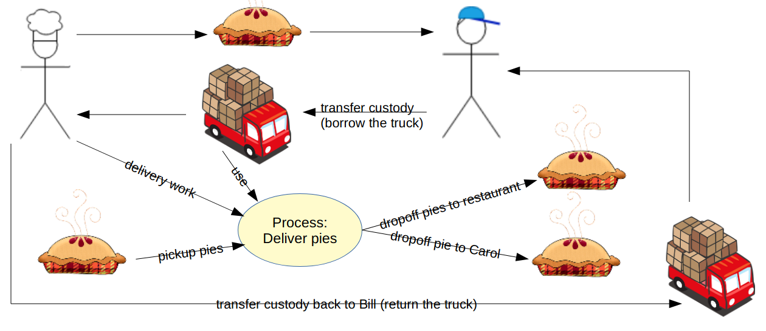
Flows: exchange and distribution
The second basic pattern for modeling resource flows is transfer, where a resource goes from one agent to another, without being changed. If there is another transfer reciprocal to the first, they are an exchange of resources.
transfer
Transfer of resources, transformation and transportation of resources, can all connect into larger resource flows. Resource flows can be of any length, and can be circular.

Slide 7
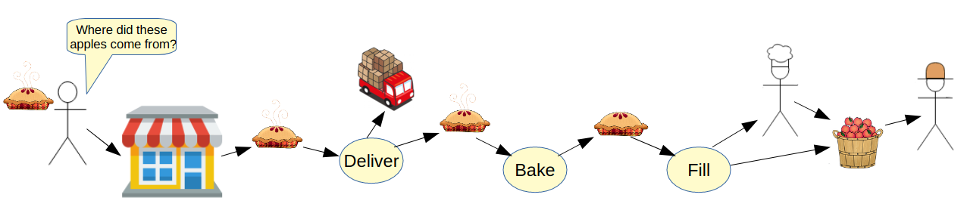
Flows: tracking and tracing
One of the most often used traces is to find the origin(s) of health problems like mad cow disease, and tainted drugs and food; then the flows are tracked forward to find all possible effects from the original problem.
A nicer story: A restaurant customer might find out that the pies are made by a local baker who uses all organic ingredients. They might find out that the apples come from a cooperative worker-owned apple orchard.

Slide 8
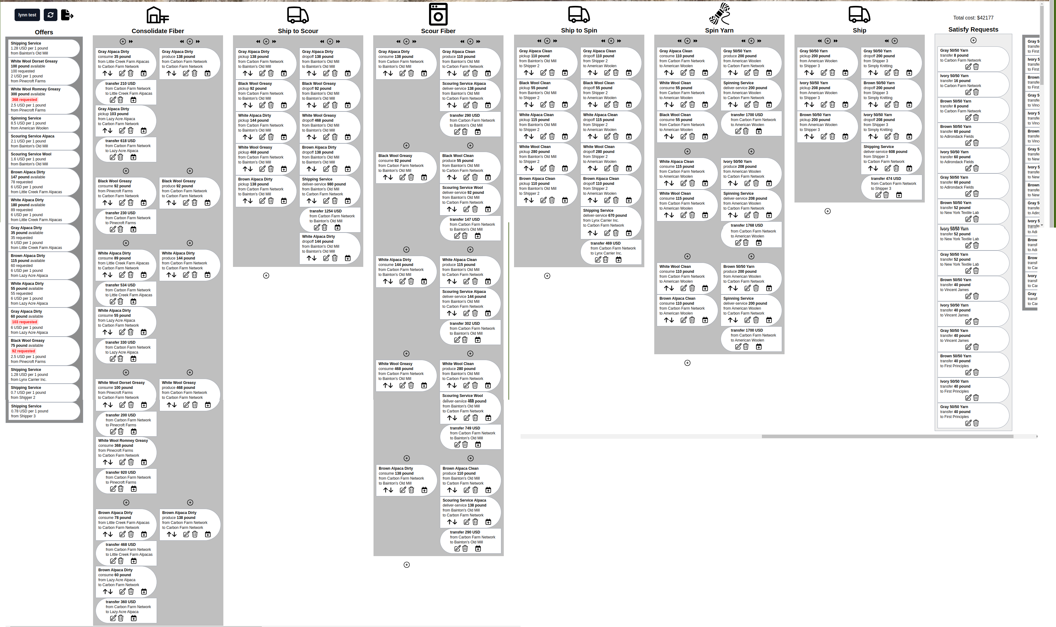
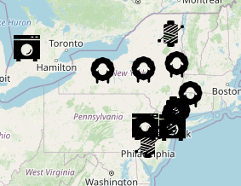
A demo of a textile supply chain
This textile supply chain includes sheep and alpaca farmers, scouring mills, spinning mills, shippers, and textile designers. Each of these is a node in the network who needs to coordinate with other nodes. In this case, the cooperative of designers coordinates the whole supply chain.

Slide 9

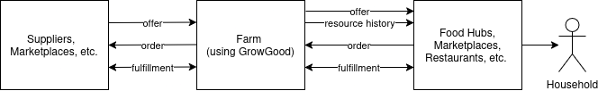
A farming app for short supply chains
“GrowGood empowers farmers to track their operations from seed to sale, creating a verifiable, auditable record of their entire production process. We are building the digital backbone for a more transparent and regenerative food system.”
GrowGood will support farm operations configurable from starting blueprints by type of farm; also sensor input, and climate and ecosystem accounting.
The arrows below are resource flows (intents, commitments, economic events) using Valueflows and JSON-LD. The software used by suppliers, marketplaces, etc. does not have to be Valueflows internally. Although one standard is best, if the api can’t be Valueflows JSON-LD, a translation layer can be written.

Slide 10
Valueflows documentation: https://valueflo.ws
Apple pie story: https://www.valueflo.ws/assets/ValueFlows-Story.pdf
Projects using VF, links to code: https://www.valueflo.ws/appendix/usedfor/
Carbon Farm Network: https://www.nycfnhub.com/
Video of CFN: https://www.youtube.com/watch?v=DlnaWGtIsBQ
GrowGood: https://growgood.org.au/en/
GrowGood slide deck: https://docs.google.com/presentation/d/1JhNjICVYa0OzzWVmz3qQcKI3FljcbyZuMi-QNHJH0GA/edit?usp=sharing

Slide 11
Thank you!
If anyone wants to do a Solid project using Valueflows, I’d be happy to help out from the Valueflows side!
Best way to contact is to ping @lynnfoster in Matrix #valueflows:matrix.org, the Valueflows Welcome channel. Also a good place if anyone just has more questions or comments.

Slide 13
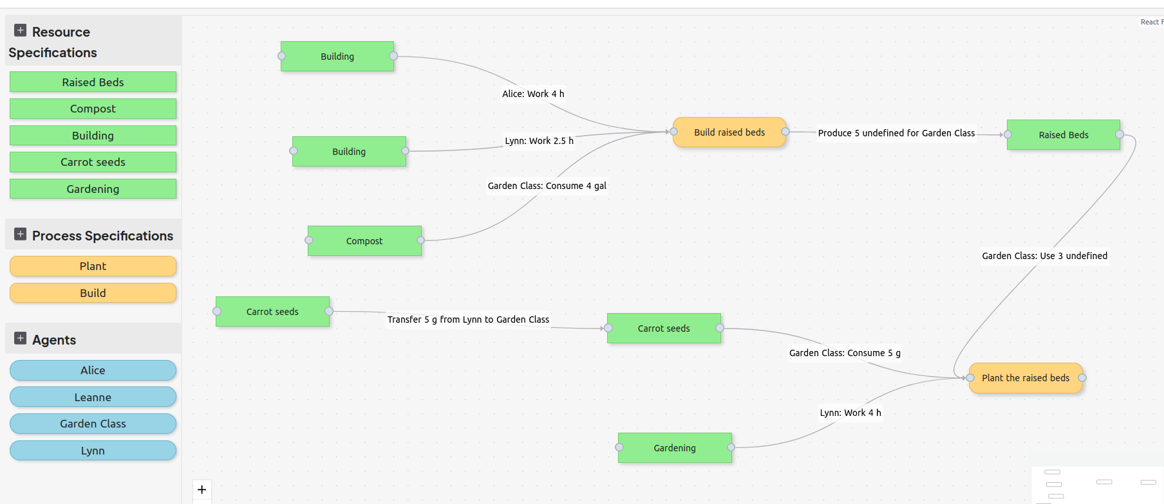

Slide 14


